Slide 1

User guide for core-CT

Slide 2
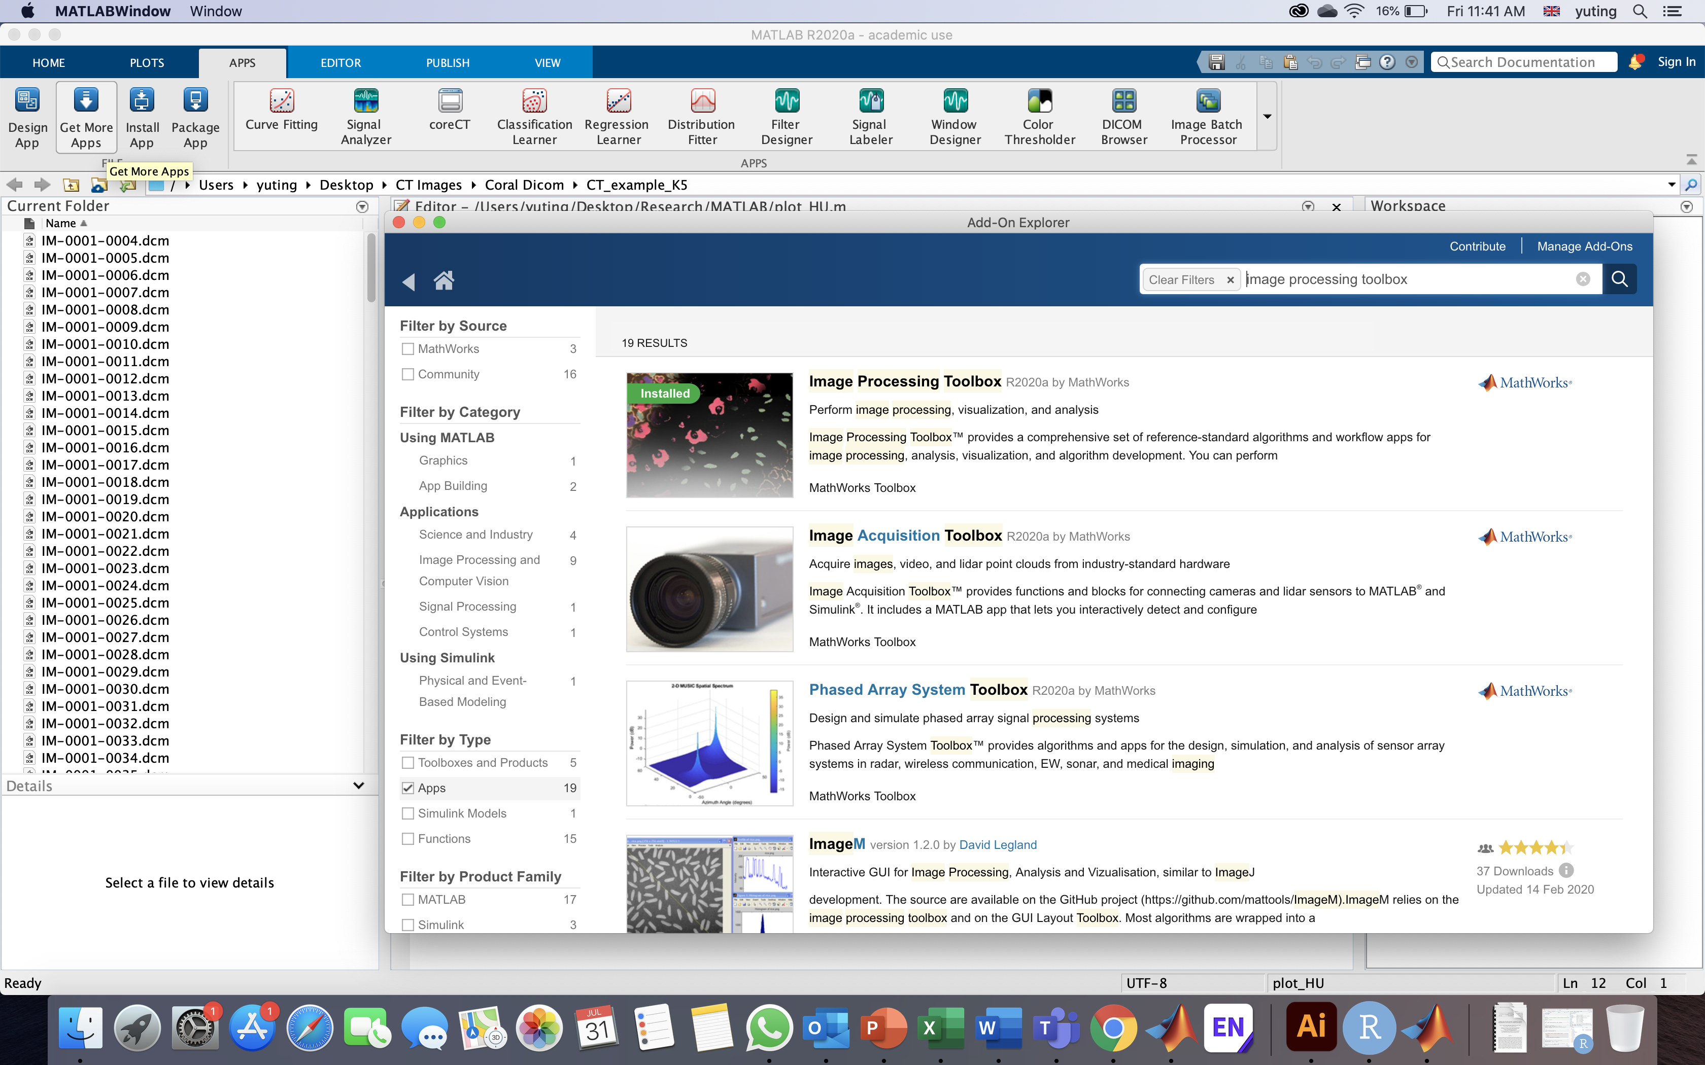
Instructions
Open Matlab
Ensure that you have at least 2019b version of Matlab with the following toolbox installed:
Image processing toolbox
Signal processing toolbox
Install the required toolbox from the “Get More Apps” button here

Slide 3
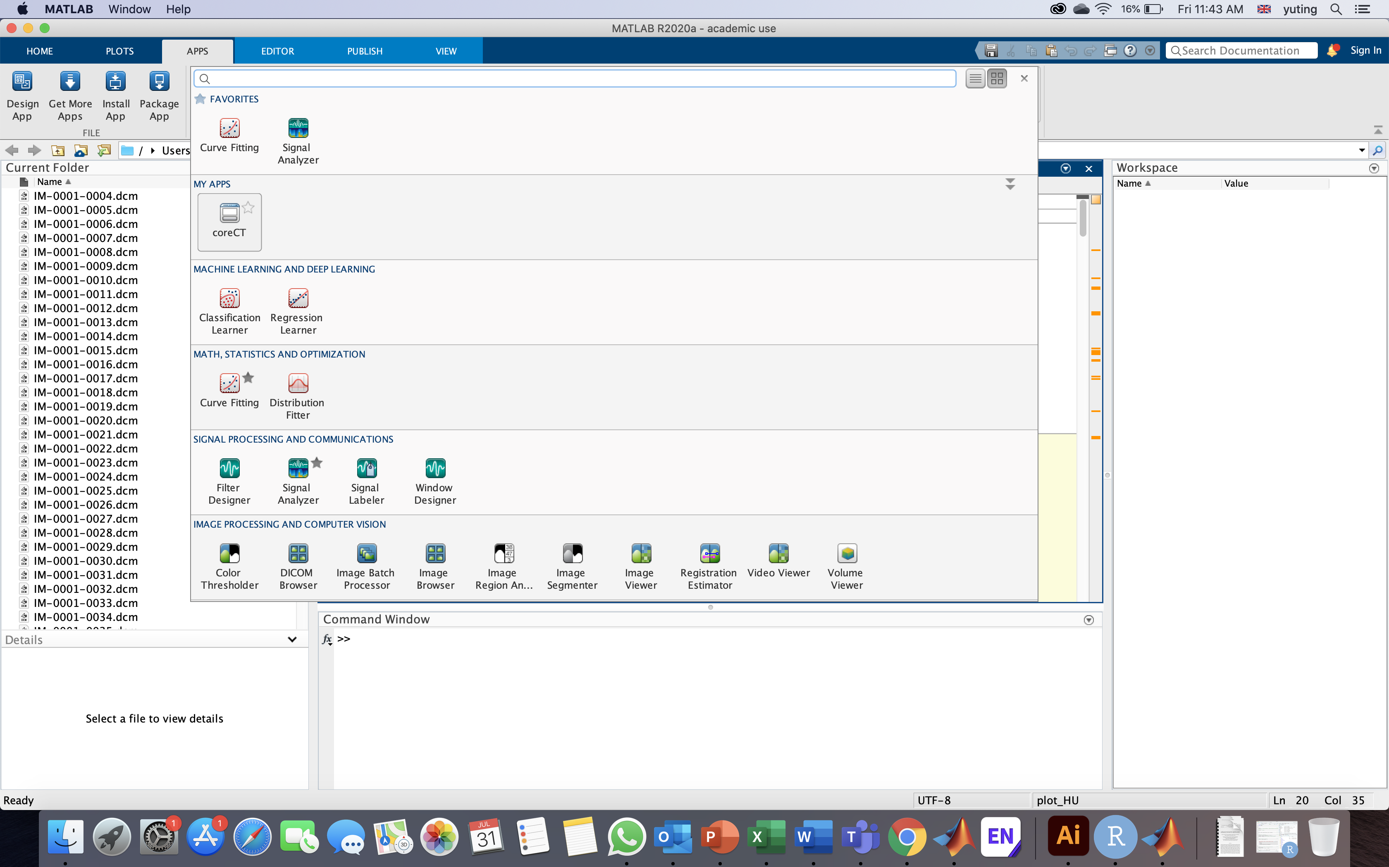
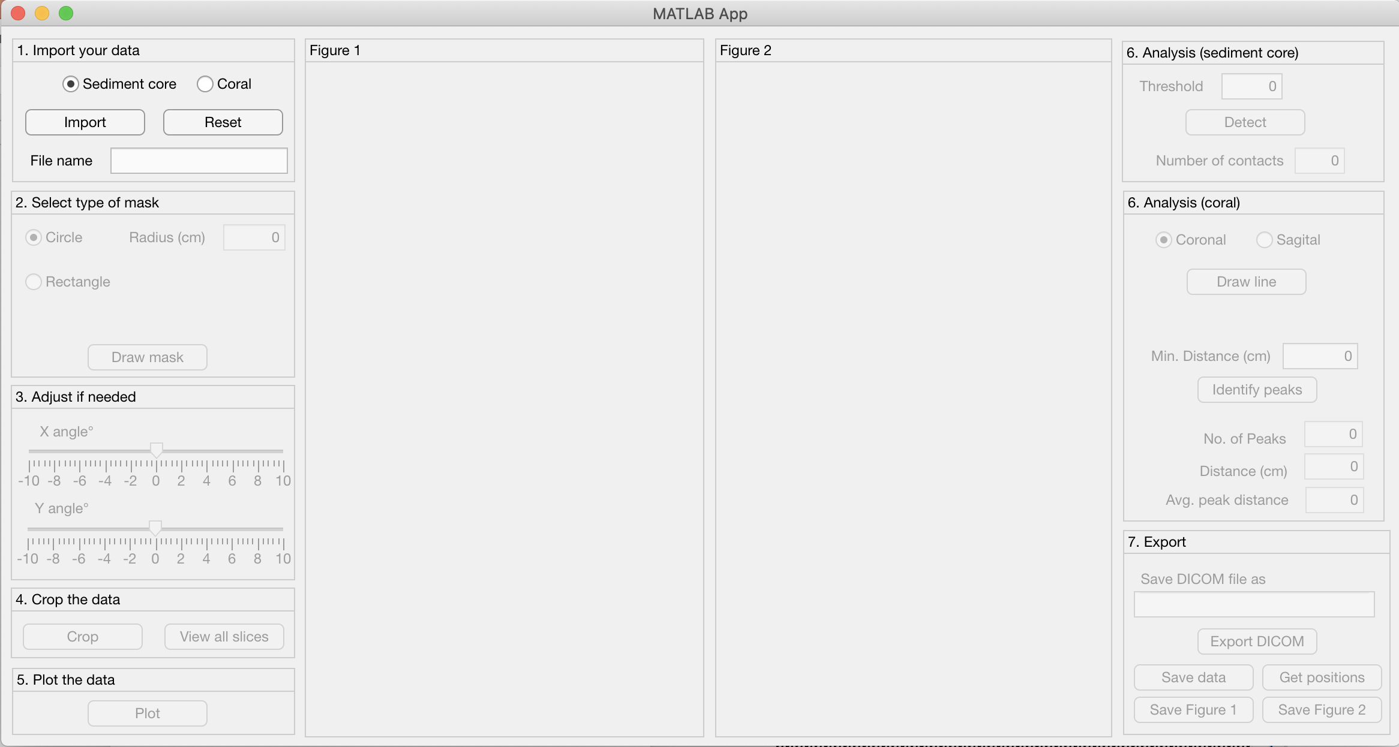
Instructions
Double click on the app to install the app. The app should appear in the “Apps” tab.
Click on the icon to run the core-CT app
This is how the app looks like:

Slide 4
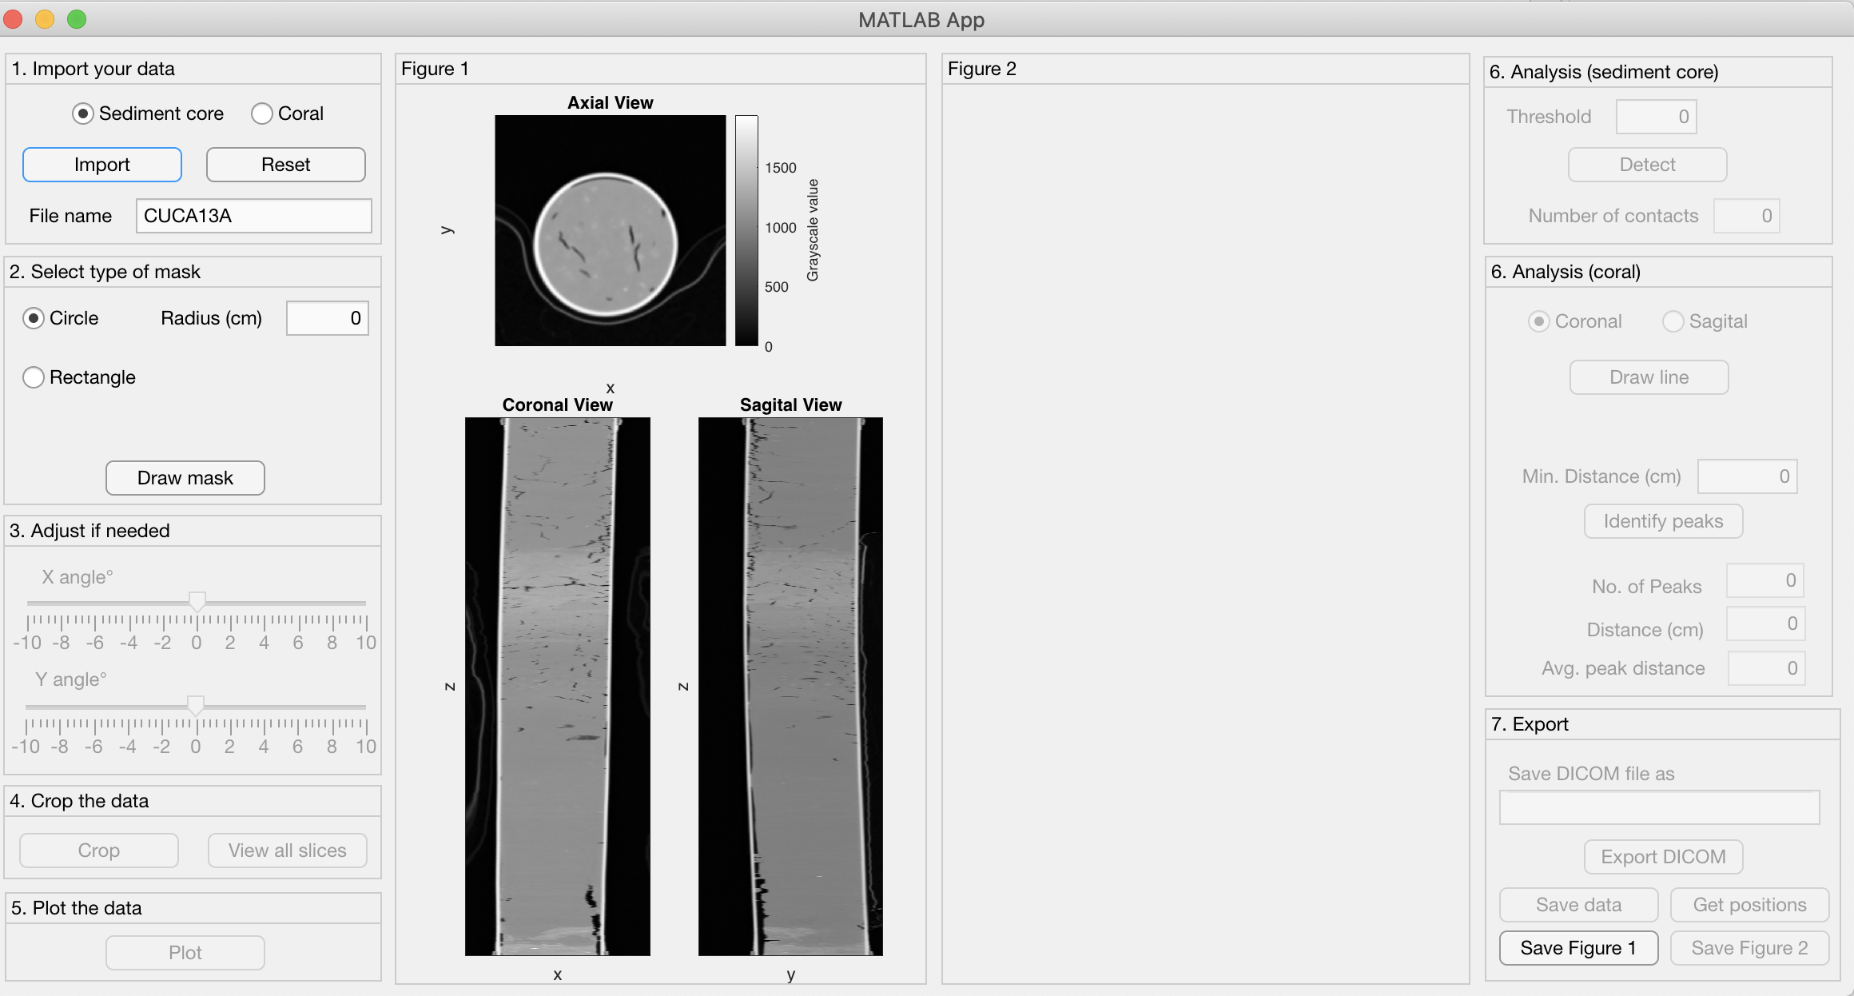
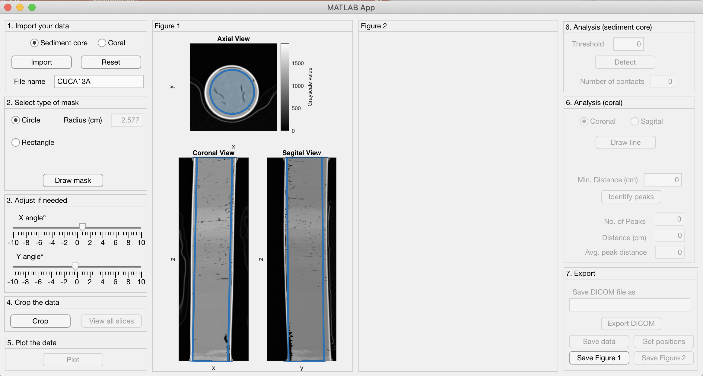
Instructions – sediment core
Ensure that you select “sediment core” before you import the DICOM files
Import – a window should pop up to locate the DICOM files
Select the type of mask that you want to draw, and draw on the Axial image
Visualisation of the mask in the axial, coronal and sagittal view
Tilt the mask if required

Slide 5
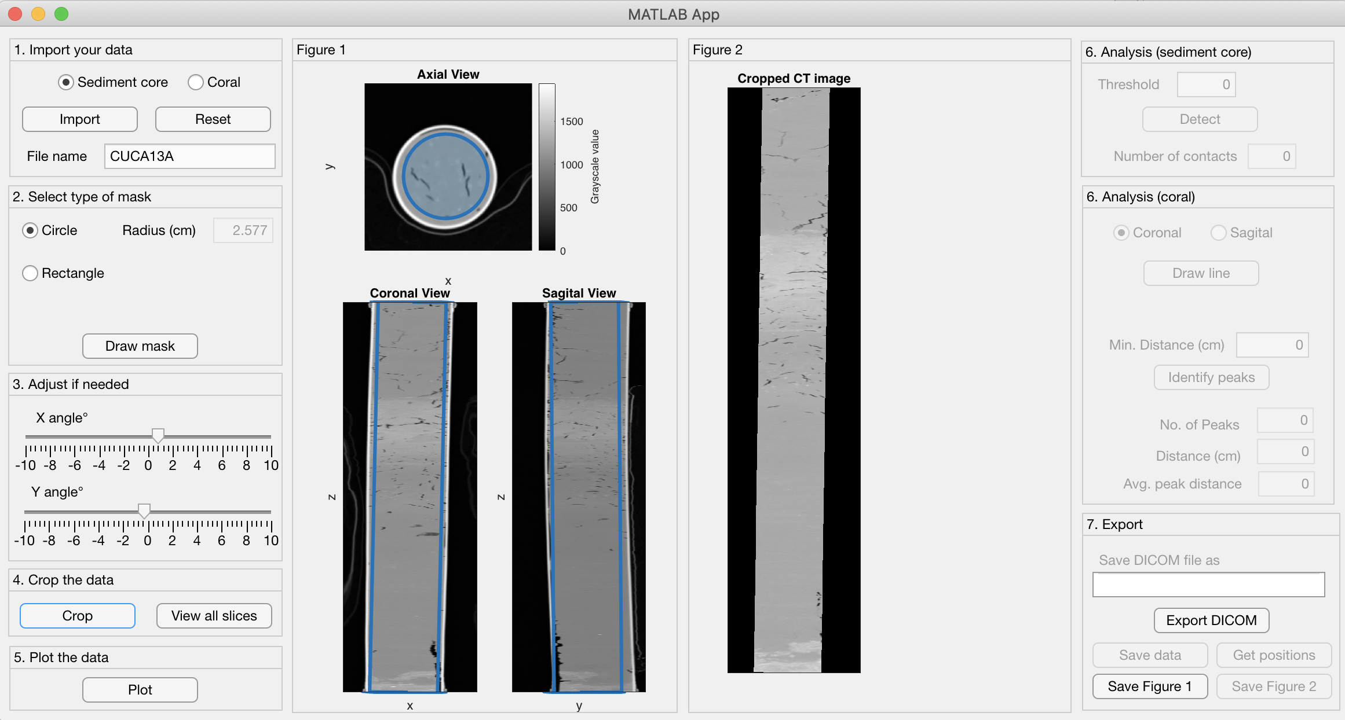
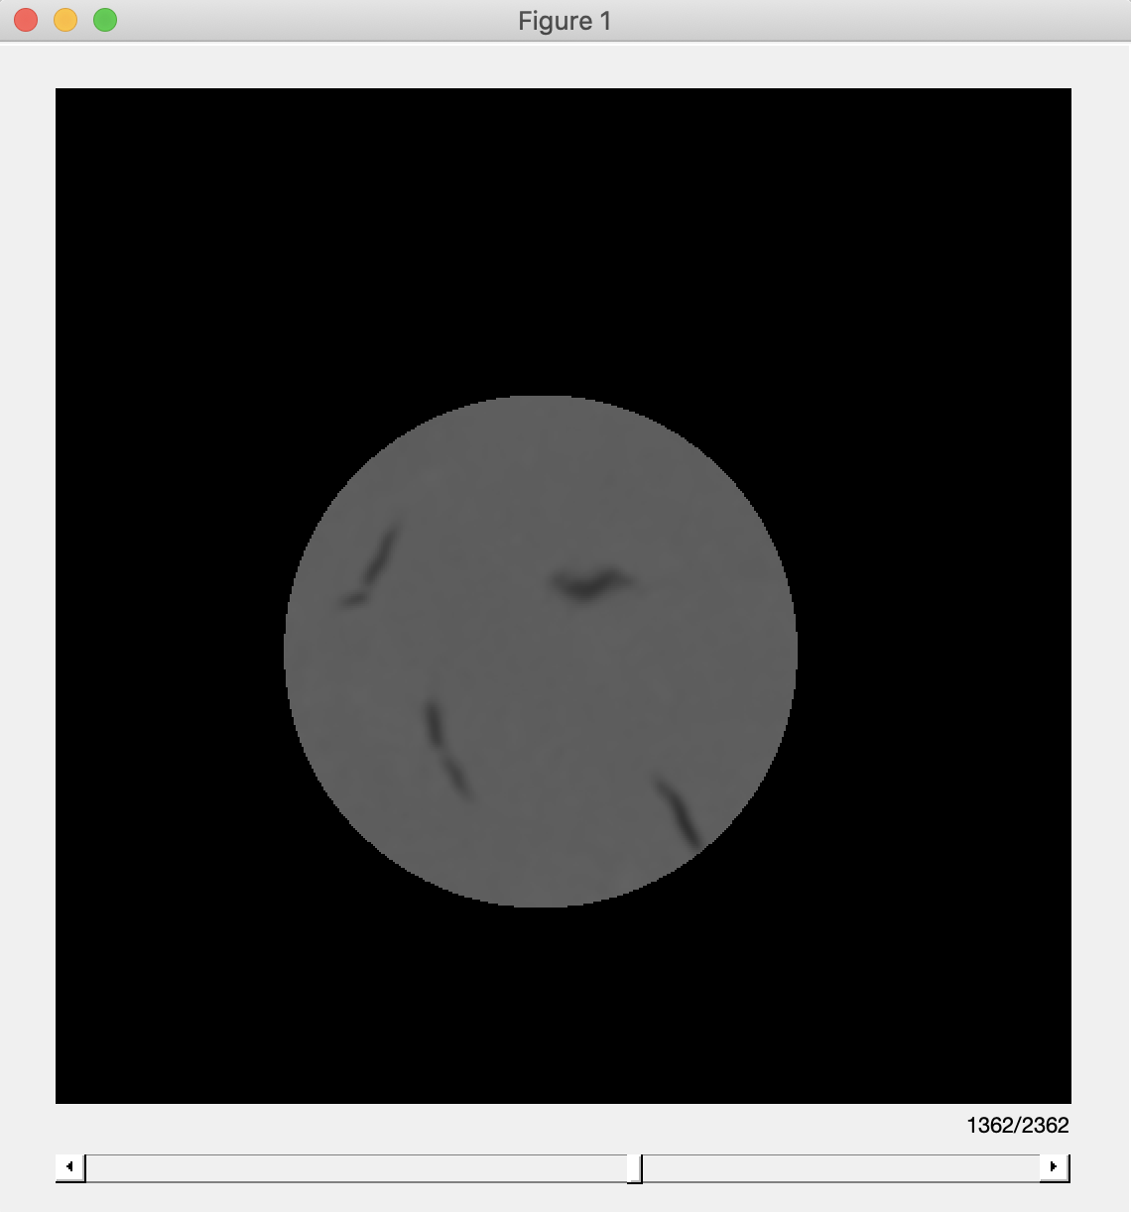
Instructions – Sediment core
Once you are satisfied with the mask, crop the DICOM images
“View all slices” button opens a window that allows you to view each image slice using a slider

Slide 6
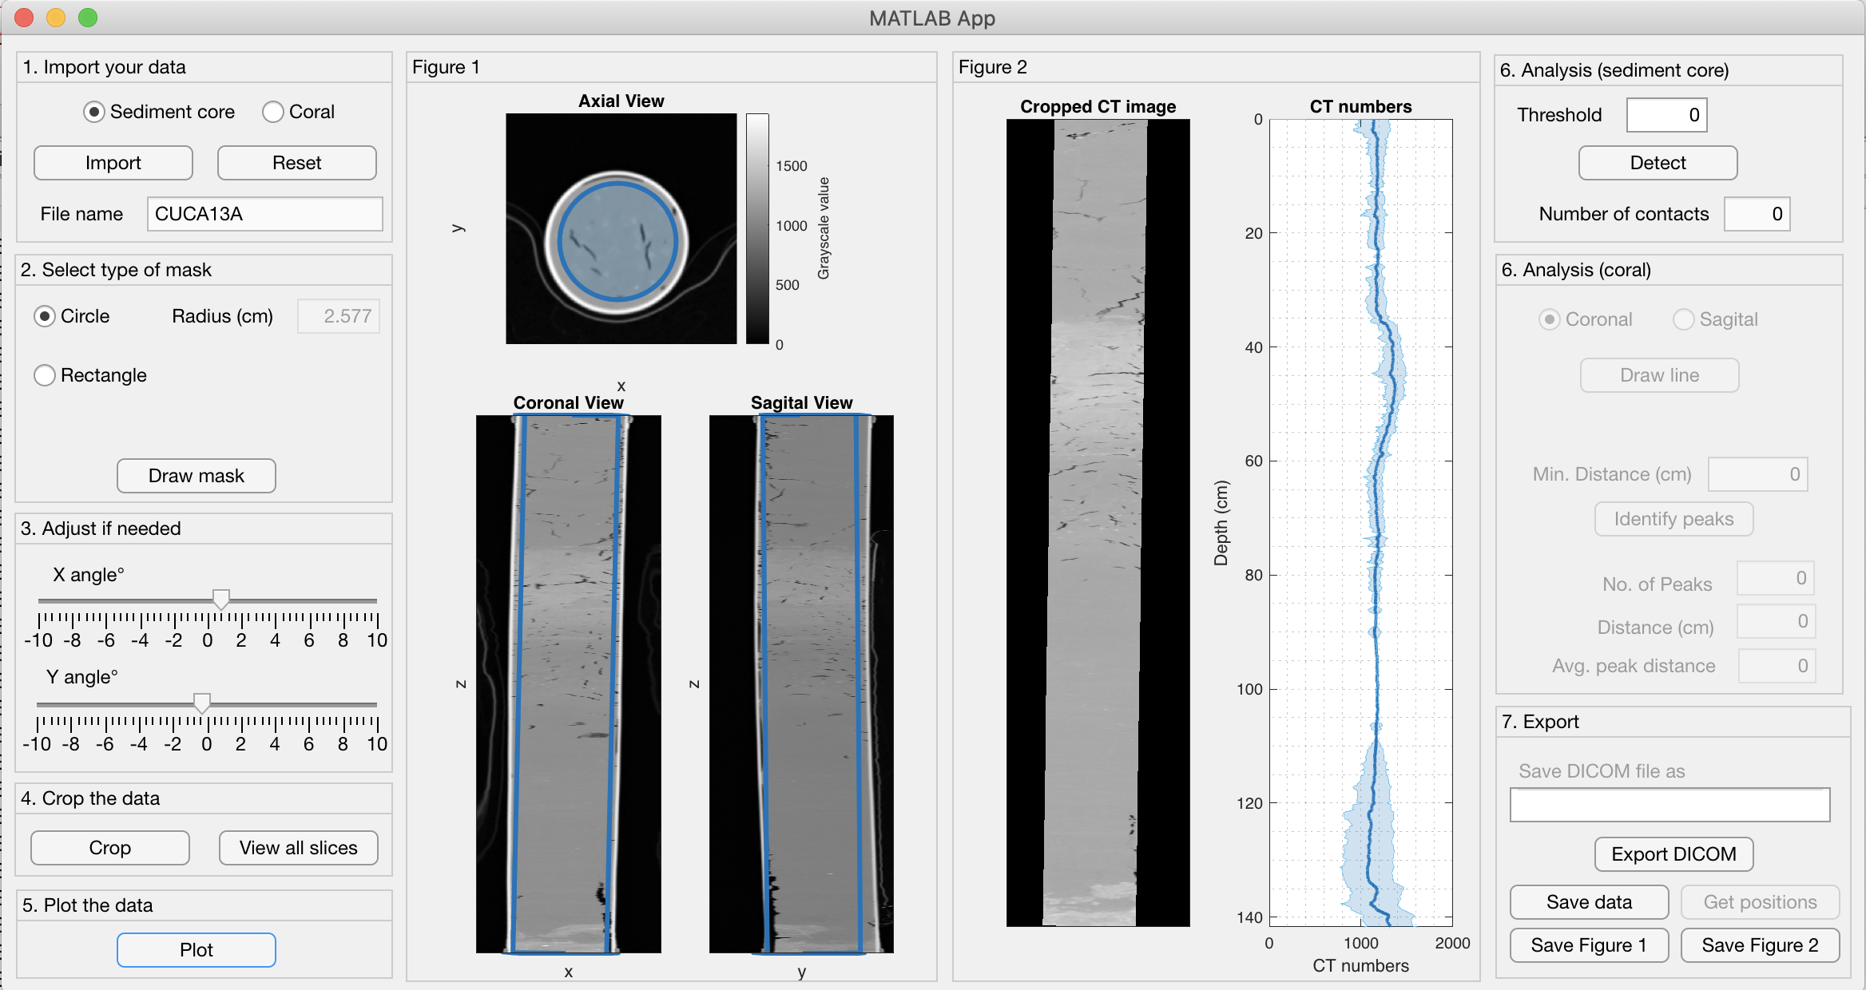
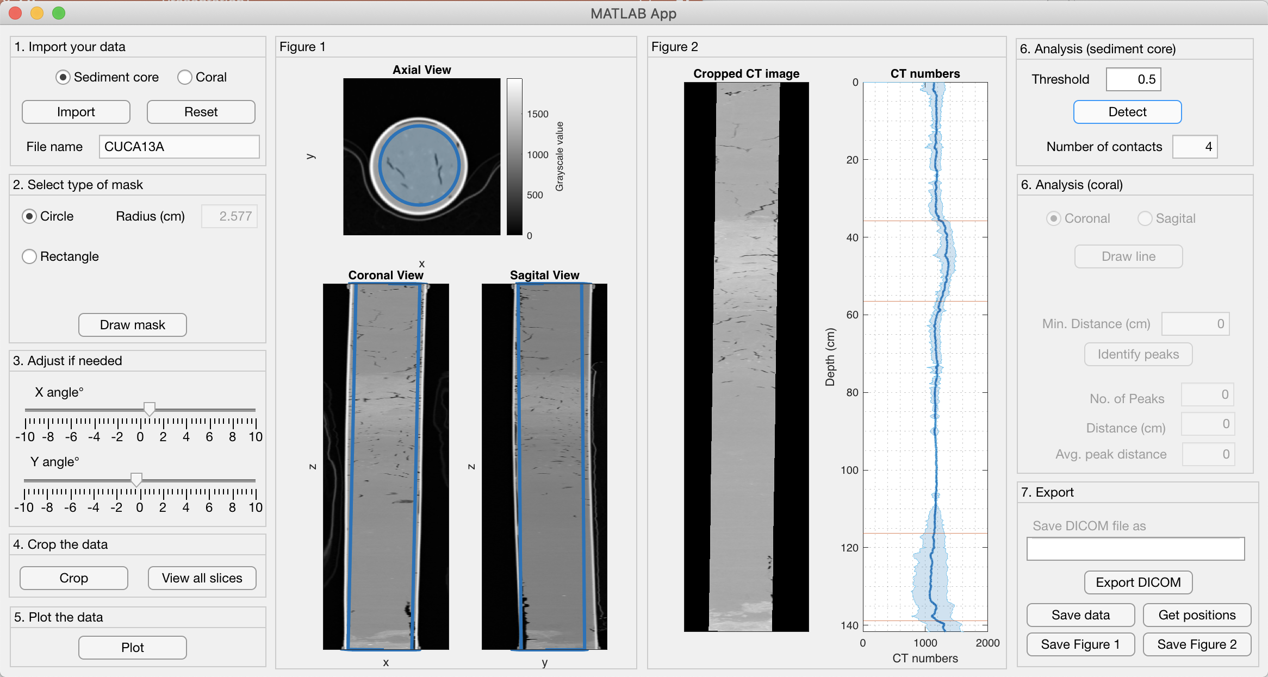
Instructions – sediment core
Plotting the CT numbers downcore from the cropped image. The CT numbers is the mean of each image slice, and the blue band represents 1SD error
Adjust the threshold and click ”Detect” to identify areas where there are sharp changes in the CT numbers

Slide 7
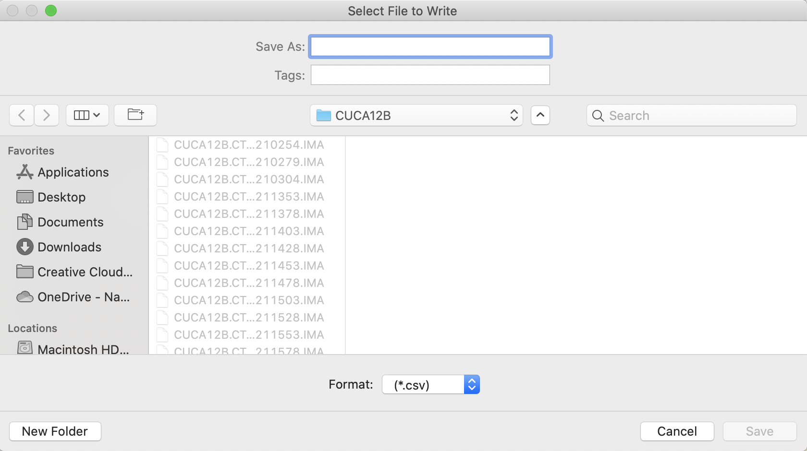
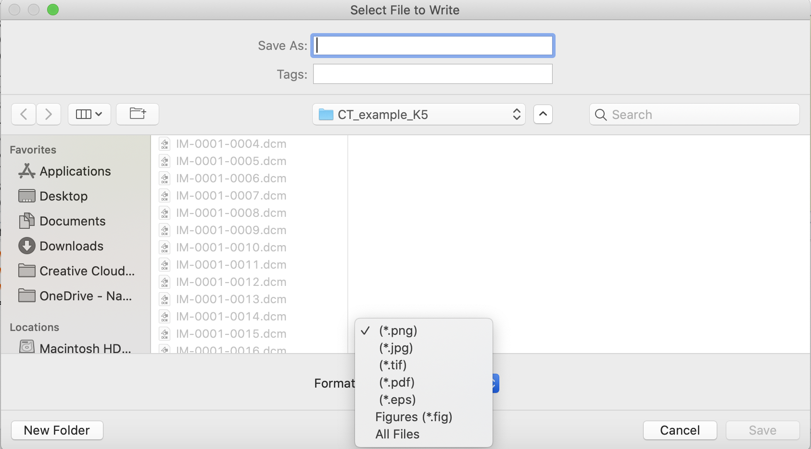
Instructions – sediment core
Option to save the cropped DICOM images, CT numbers and figures
Exporting cropped DICOM images: Fill in the folder name for the DICOM images to be saved into
Exporting the figures:

Slide 8
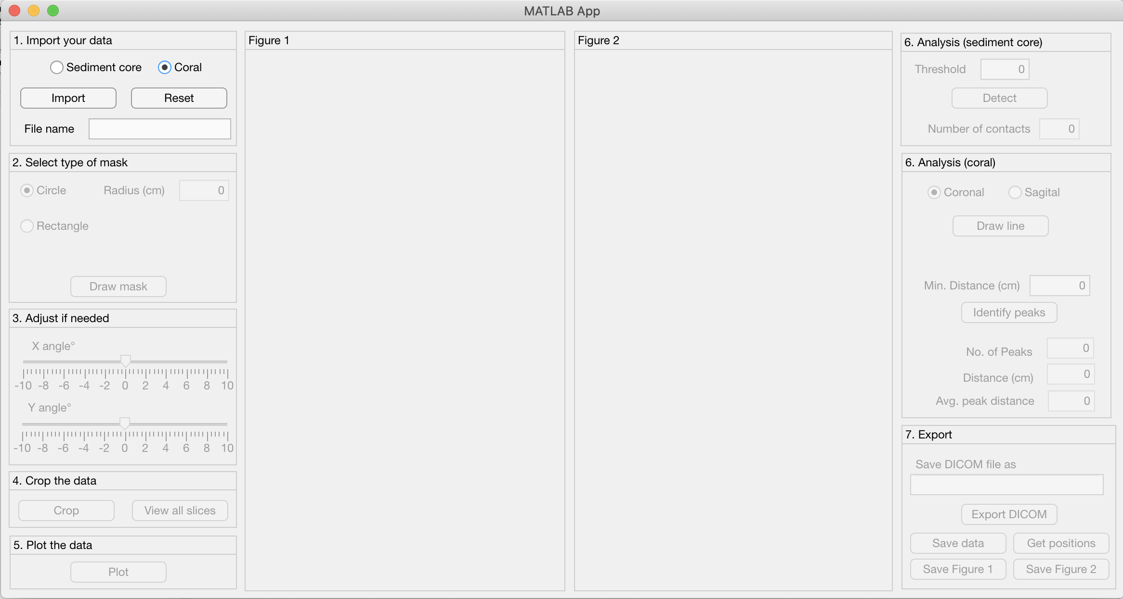
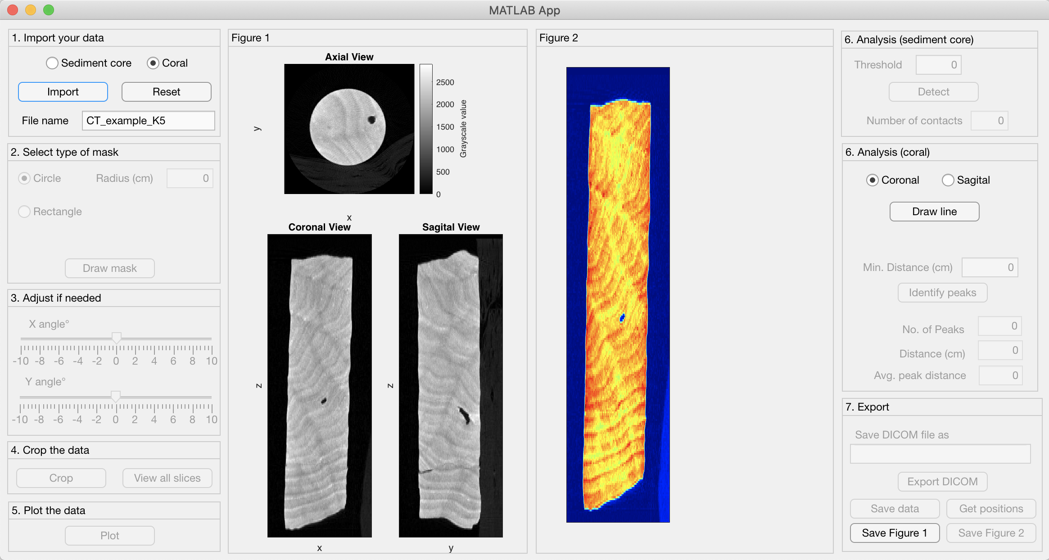
Instructions – Coral
Ensure that you select “coral” before you import
Visualisation of the coral DICOM image

Slide 9
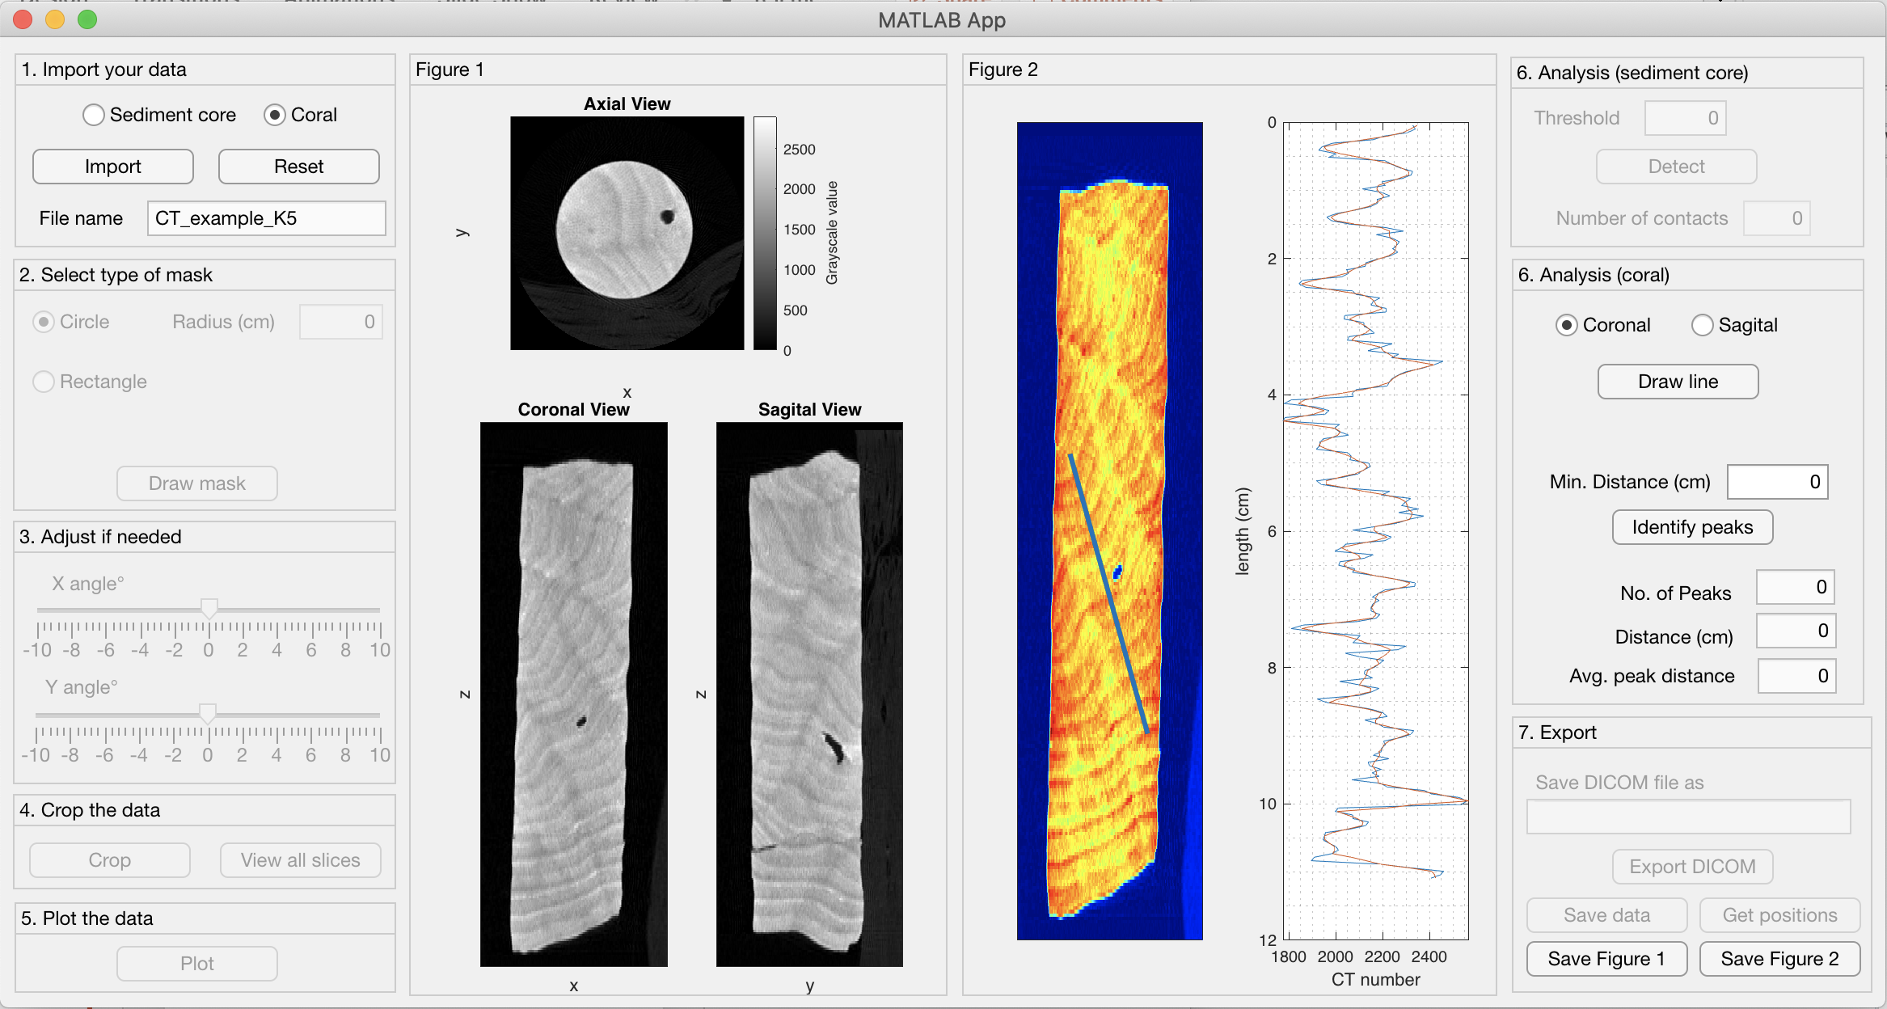
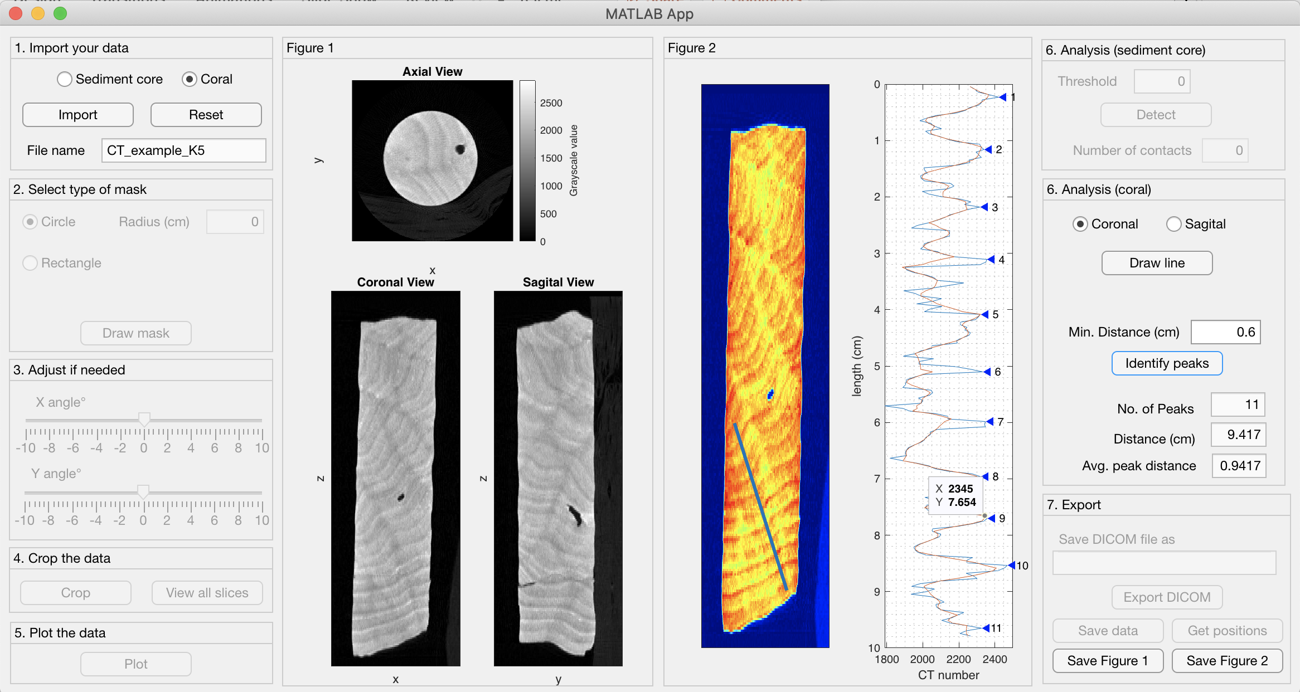
Instructions - coral
Choose either “Coronal” or “Sagittal” image and draw a line on the image
Define a minimum peak distance and identify the number of peaks present in the profile across the line that was drawn
Figures can be exported as well

